Slide 1

Git Clone
Konkuk University, Department of Computer Science/Software
Jason. HW. Kang

Slide 2
Contents
1. Friendly with Command line!
2. JUST-DO-IT: Clone sample repository
3. Understanding cloning
4. Other cloning options on command line

Slide 3
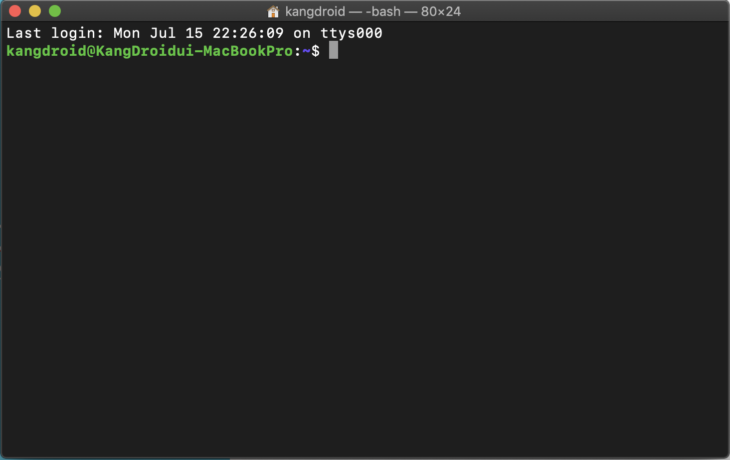
The Commandline (Friendly with Command Line!)
Command line usally look like this(macOS):

Slide 4
The Commandline (Friendly with Command Line!)
Command line usally look like this(Windows 10):

Slide 5
The Commandline (Friendly with Command Line!)
Command line usally look like this(Ubuntu):

Slide 6
The Commandline (Friendly with Command Line!)
Each OS/Shell(Command Prompt) has unique command line sets
Normally default shell on macOS/ubuntu shares most command line(Bash)
Windows has different command line sets except for “cd”

Slide 7
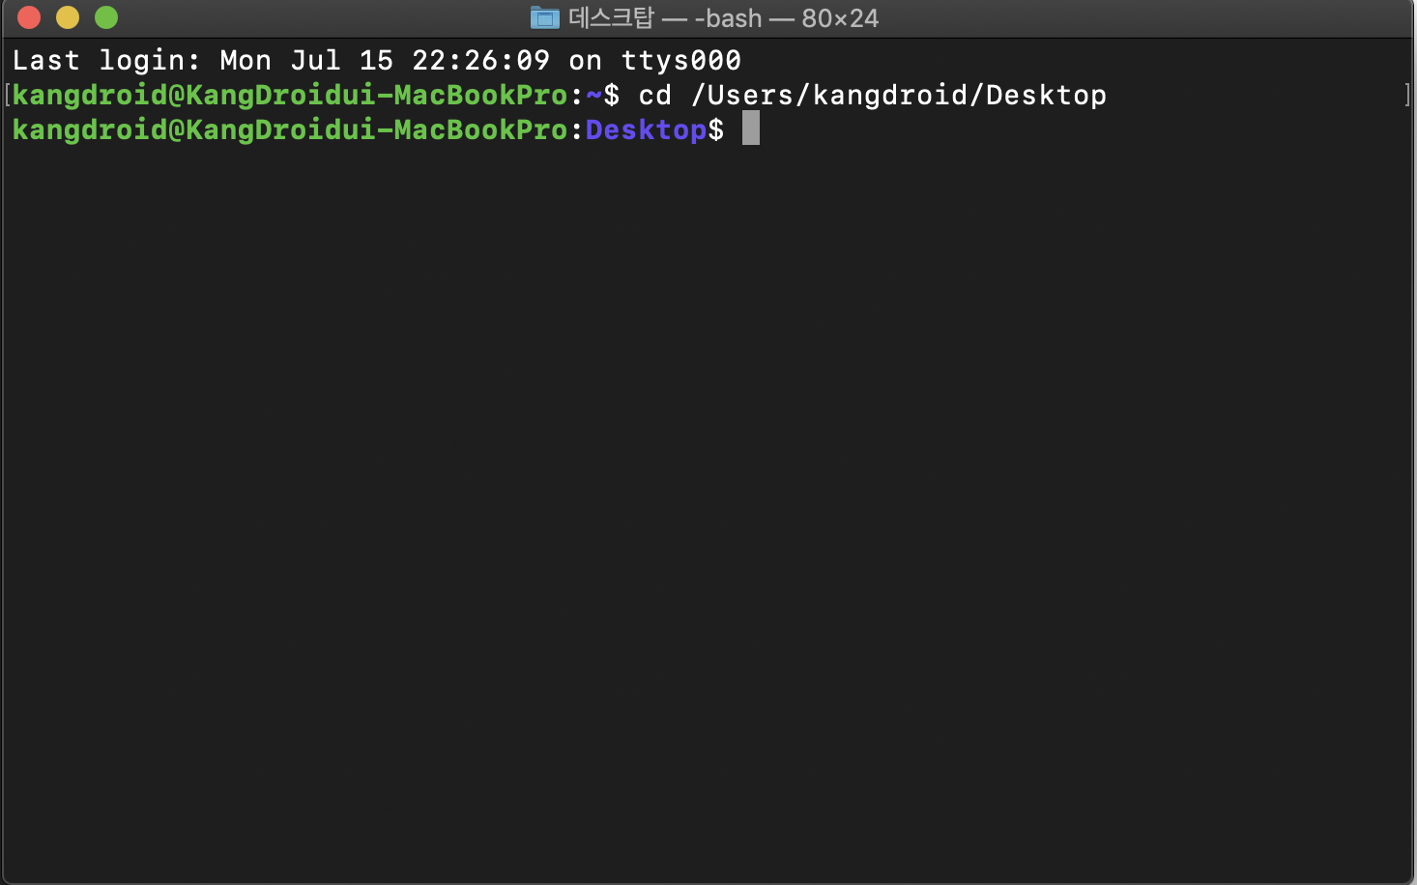
The Commandline (Must-Needed Command: cd)
cd: Synonym for “Change Directory”
Usage: “cd <PATH_TO_DIRECTORY>”

Slide 8
JUST-DO-IT! (Cloning: Brief)
Last part of instructions/lecture, we created new empty repository on github.
Now we are going to clone it to somewhere in your device(it’s your choice!)

Slide 9
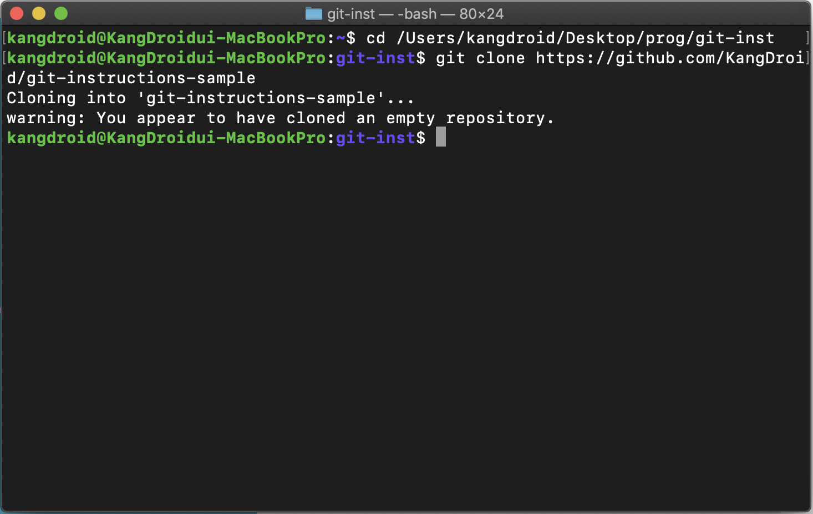
JUST-DO-IT! (Cloning:CMD)
$cd <to wherever you want>
git clone https://github.com/your-id/your-repository

